Slide 1


SOEN-6441 Advance Programming Practices Project
Winter 2021
Build 1
Submitted To:
Prof. Joey Paquet
Submitted By: TEAM – 09
Avneet Pannu [40168576]
Bhoomi Shah [40169655]
Jhanvi Arora [40162512]
Pulkit Kakkar [40160971]
Zalak Patel [40164315]

Slide 2
Coding Conventions

Slide 3
Code Layout
Indentation
Indentation of 8 spaces.
Body of the function is indented w.r.t. its header.
Body of loop and conditional statements are indented w.r.t. their initial line.
Position of Curly Braces
An open curly brace is appended to the statement preceding it, hence minimizing the code length.
Line Spacing
Blank Lines are used to separate code
Added between class declarations, methods, and major sections of long, complicated functions to improve readability.
Spacing between Operators and Operands
int example = val1 + val2 + val3 //good practice
int example=val1+val2+val3 //bad practice

Slide 4
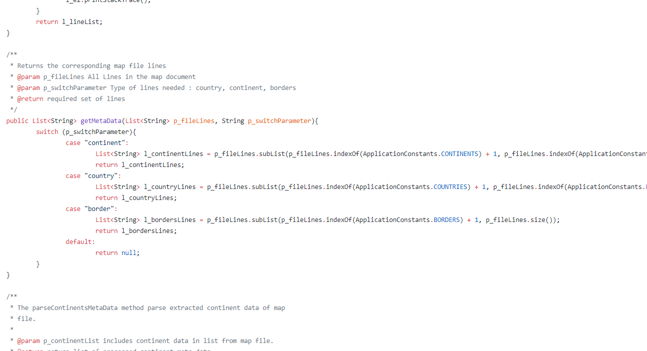
MapService.java

Slide 5
Naming Conventions
Classes
Class names are in upper CamelCase (Pascal Case).
class ThisIsExampleClassName { /*code*/ }
Data members, Member functions and Method Parameters
Both are in lower camelCase.
int thisIsExampleFunction(int p_param1, int p_param2) { /*code*/ }
int d_playerName = “AmazingSova”;
Static Members/Constants
UPPER_SNAKE_CASE letters with underscores in between the words.
int THIS_IS_EXAMPLE = value;
Local Variables
Follows lower camelCase along with “l_” stating it is a local variable
bool l_mapExists = “false”;

Slide 6
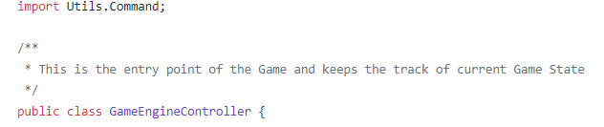
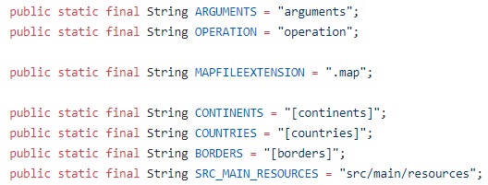
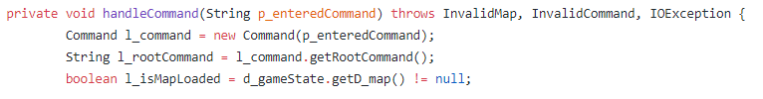
GameEngineController.java
ApplicationConstants.java
GameEngineController.java

Slide 7
Commenting Conventions
Javadoc
Javadoc for all the classes, data members and member functions will be mentioned above them.
/**
* mentioned above classes and methods.
*/
@return type description
@param parameter_name description
@throws exception description
Long Methods
Meaningful explanation added in between long, complicated methods to enhance code understanding.
No Commented-out Code
Unnecessary commented code is deleted to improve readability.

Slide 8
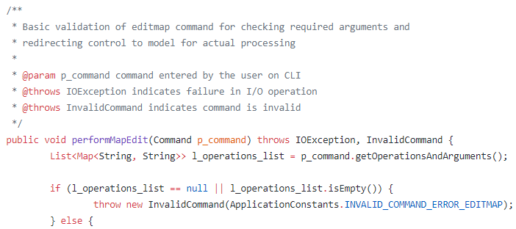
GameEngineController.java
GameEngineController.java

Slide 9
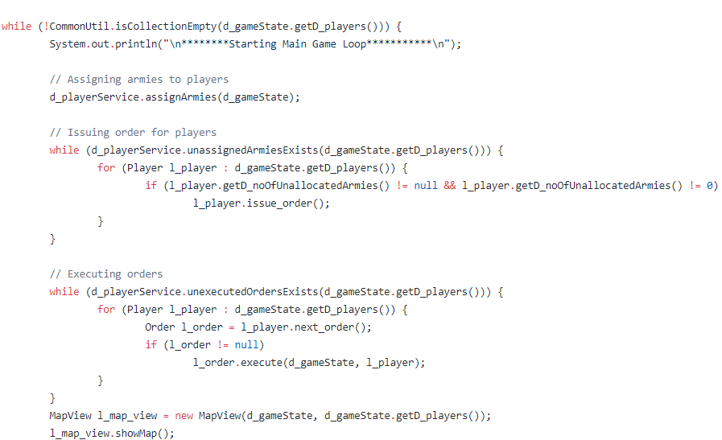
GameEngineController.java

Slide 10
References
As mentioned in the Project Build #1 handout.

Slide 11
Thank You

